Slide 1
ACCESS SERVICE
REQUEST
-Aalo Chatterjee

Slide 2
What is ASR?
A request from one telecommunications company to another for any of various types of interconnectivity or data sharing needs.
Access Service Request (ASR) is a set of uniform order request forms containing administrative data common to all orders. ASR is associated with one or more order forms, each of which specifically defines a requested configuration.
A request that a Telecommunications Company (TC) provides to another TC for various types of interconnectivity or data sharing needs. These requests can be between Incumbent Local Carriers (ILEC) and Competitive Local Carries (CLECs) or ILECs and a Long Distance Carrier (IXC). An IXC can originate an ASR to either an ILEC or a CLEC.
ASRs provide an automated way of ordering carrier-to-carrier, regional, and inter-LATA services.

Slide 3
Who uses ASR Ordering Tools?
CLEC’s
  Data CLEC’s that want to expand their services and their markets by entering the Voice and higher capability data services.
ISP’s
  Internet Service Providers that want to build out their own network.
IXC’s
  Inter-Exchange Carriers will also utilize ASR for the Inter and Intra-LATA services that carry voice and data.

Slide 4
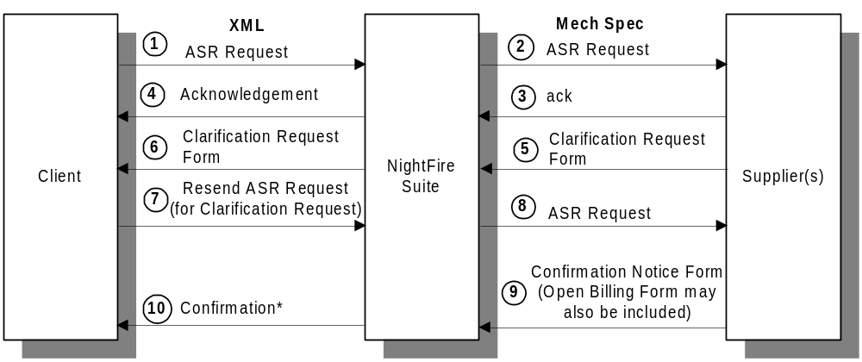
ASR Workflow

Slide 5
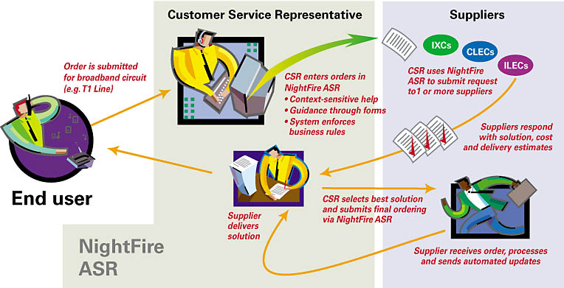
ASR

Slide 6
ASR Processing Chains
A gateway provides an interface to a Trading partner.
The following gateway processing chains are used as per ASR send:
ASR ORDER:
Send processing chains
Receive processing chains
Fax processing chains
ASR PREORDER:
Send/Receive processing chains

Slide 7
ASR Client-Side Logging
Client-side logging refers to messages which are logged in NightFire’s standard XML format prior to mapping to the MECH SPEC format as well as responses from the supplier after they have been mapped from MECH SPEC to XML.
Client
NightFire
Suite
Supplier
ASR_MESSAGE
MECH_SPEC

Slide 8
ASR Supplier-Side Logging
Supplier-side logging refers to messages which are logged in the MECH SPEC format prior to transmission to the supplier as well as MECH SPEC messages received from the supplier.
Client
NightFire
Suite
Supplier
ASR_MESSAGE
MECH_SPEC

Slide 9
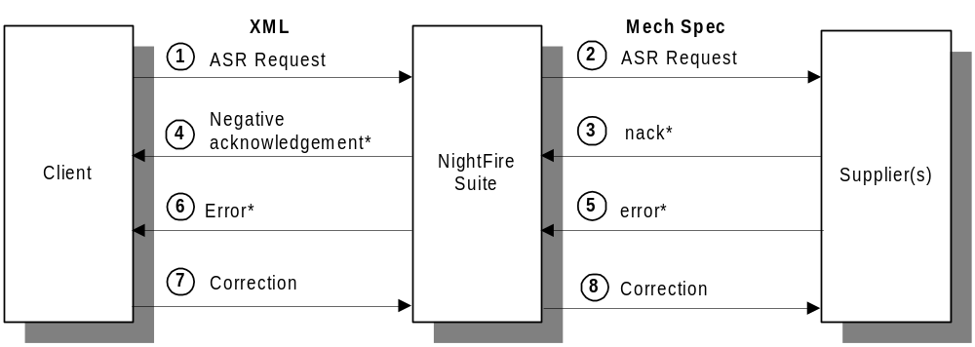
ASR Workflow Error Handling

Slide 10
Error Handling
Communication Errors:
Occur when the communication between a client and supplier is down.
Data Errors
Occur when required fields are missing or contain the wrong kind of data.
XML mapping errors: XML mapping generate error messages in the SPI logs and exception directory
System Errors
Occur when one or more of the NightFire Suite servers is down.

Slide 11
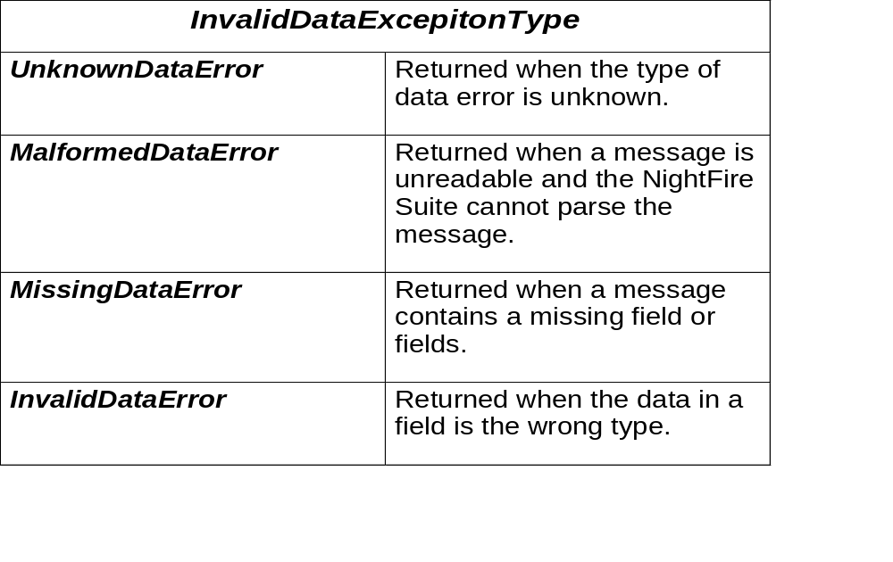
ERROR TYPES

Slide 12
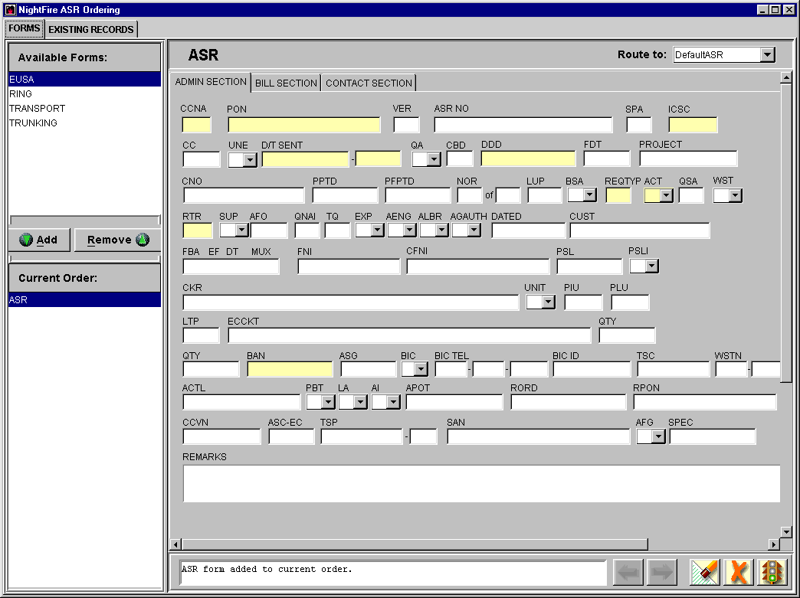
ASR Ordering Forms
The ASR is comprised of various forms that contain data to order a particular set of services. Each type of service requires certain forms to be sent to the providers in order to process an order successfully.
Types of ASR GUI Forms
Transport Service
Virtual Connection Service
Ring Service
Switched Access Service

Slide 13
Nightfire ASR Ordering form

Slide 14
ASR FORMS
Transport Service:
-This form is used by the customer to order private line type services. Transport Services are categorized by being either switched (shared) or non-switched (dedicated) services.
Virtual Connection Service
  -This form is used for broadband services where Frame Relay and ATM Networks are used.
  Frame Relay to ATM
  ATM to Frame Relay
  Frame Relay to ATM to Frame Relay

Slide 15
ASR FORMS
Switched Access Service
-Public telecommunications services where users share transmission and switching facilities.
Ring
  This form is used by the customer to order ring service, commonly called SONET (Optical Network).Dedicated, high-capacity, self healing network service designed to provide increased reliability, availability, and functionality via ring topologies among multiple customer locations ASR Validation.

Slide 16
ASR VALIDATION
to perform order and field validation according to ASOG guidelines to insure completeness of the order.
standard ASOG business rules should be applied to incoming requests – There should be a way for customers to turn business rules on or off.
allow for manual correction of incoming ASR’s and outgoing responses. This would allow a CSR to be able to edit both the incoming request, and outgoing responses via a gui.

Slide 17
Response Transmission
Billing Account Number Correction
( BANC)
Error
Confirmation (FOC/DOC)
Service Request Confirmation (SRC)
Access Provider Correction
Clarification Request

Slide 18
ASR GUI
Consists of User Interface and set of business rules.
ASR GUI running on an NT machine, ASR Server running on UNIX.
ASR Server
NT
NT
NT
NT
NT

Slide 19
ASR REPORTS
Error/Supplement Report
SLA Miss Report
Reject Rate/Reason Code
FOC SLA Report
Changed FOC Date Report

Slide 20
QUESTIONS?
      THANK YOU
-Aalo Chatterjee

